Slide 1
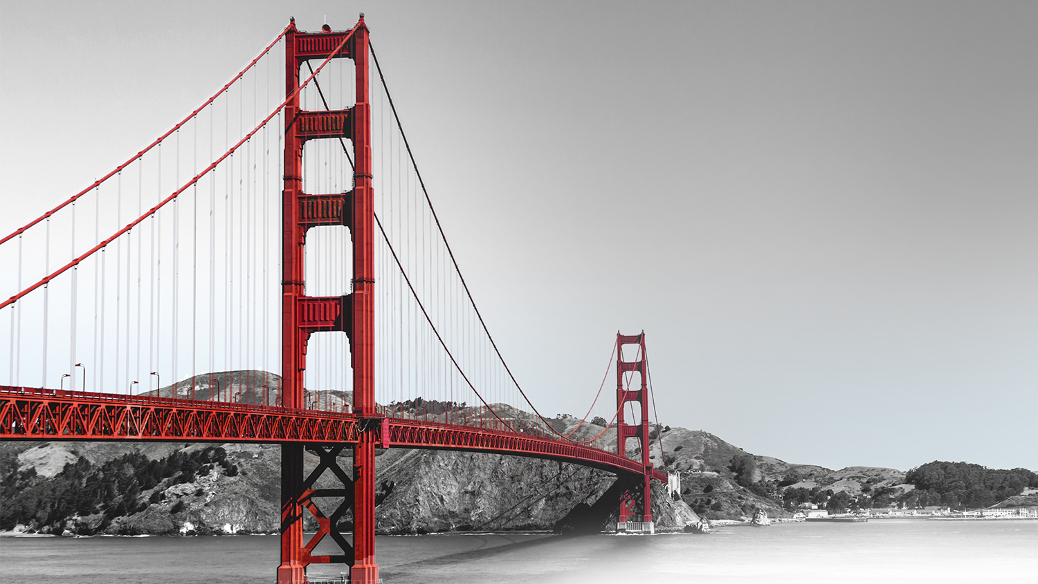
NextEra
Team Invenco
10/2019

Slide 2
POWERLINE VEGETATION CONTROL BY USING SATELLITE IMAGERY

Slide 3
Introduction
We present in this document on use case of Powerline Vegetation Control application
We utilize results in following technics
Object detection for utilities
Semantic segmentation for power lines
Open street maps element retrieval
Satellite imagery processing

Slide 4
APPLICATION

Slide 5
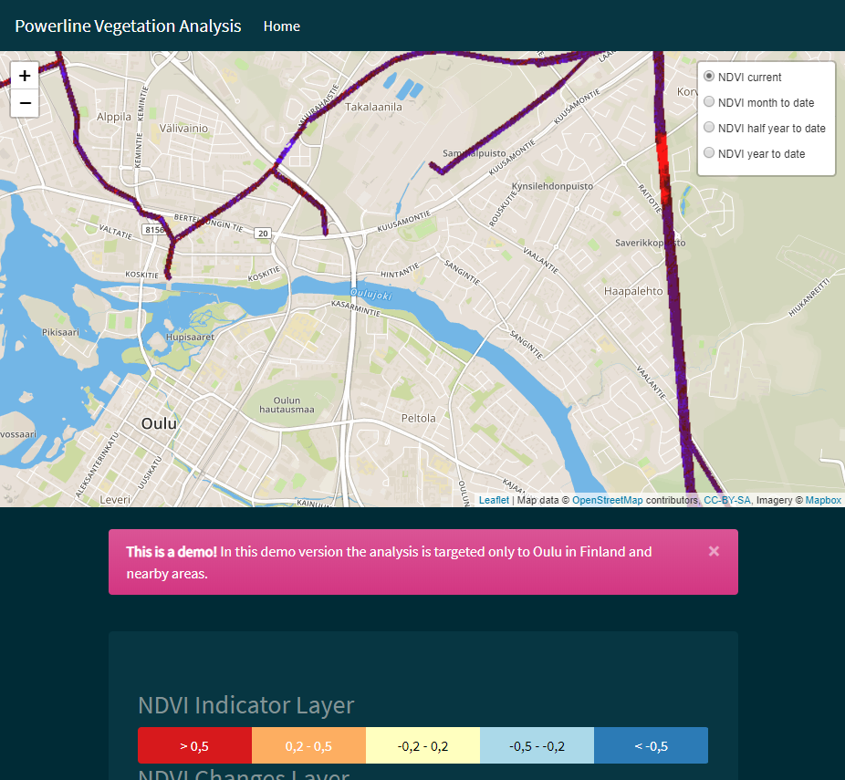
Video, Sources and Demo
Please look the following link in Youtube
Powerline vegetation v3
Source codes can be found in
https://github.com/lahdeaho/NextEraHackathon
The demo can be found in
http://powerlines.westeurope.cloudapp.azure.com:5555/

Slide 6
Application
Problem
Uncontrolled powerline vegetation causes electric outages directly by tree branches and indirectly with snow weight gathered on tree branches to make them fall on lines
Solution
We build automatic process where satellite imagery and digital elevation model are processed and combined to powerline location information for calculation of current vegetation level and also changes from different time steps to history

Slide 7
Automatic Daily Process (ADP)
There are five main phases which makes the data pipeline
The application visualizes the results in web site
Read satellite imagery
Get NDVI and DEM from imagery
Reconstruct with Super Resolution
Calculate heatmap
Calculate changes

Slide 8
ADP: Read Satellite Imagery
At first we need to check new products from European Space Agency (ESA) portal
Then newest products will be downloaded to processing folder
Read satellite imagery
Calculate changes
Get NDVI and DEM from imagery
Calculate heatmap
Reconstruct with Super Resolution

Slide 9
ADP: Get NDVI from Imagery
NDVI = Normalized Difference Vegetation Index
https://en.wikipedia.org/wiki/Normalized_difference_vegetation_index
B08 = Band 8 (VNIR, visible and near infrared)
10m resolution
842 nm central wavelength
B04 = Band 4 (Red)
10m resolution
665 nm central wavelength
NDVI formula:
(B08 – B04) / (B08 + B04)
Read satellite imagery
Calculate changes
Get NDVI and DEM from imagery
Calculate heatmap
Reconstruct with Super Resolution

Slide 10
ADP: Get DEM from Imagery
Interferogram
Export to SNAPHU
Run SNAPHU
Import from SNAPHU
Phase to Elevation
Terrain Correction
Read
Read 2
Read satellite imagery
TOPSAR-Split
TOPSAR-Split 2
Apply-Orbit-File
Appy-Orbit-File 2
Calculate changes
Get NDVI and DEM from imagery
Back-GeoCoding
Interferogram
TOPSAR-Deburst
TopoPhaseRemoval
Calculate heatmap
Reconstruct with Super Resolution
GoldsteinPhaseFiltering
Write
[1,2,3]

Slide 11
ADP: Reconstruct with Super Resolution
Super Resolution is deep learning technic
Neural Network model is trained with images to learn how to add extra information to pixels
That way image resolution can be increased to x2 – x8 times bigger
Nvidia Volta and Turing GPU has own super resolution models and that can be used with NGX SDK
We build also our own model and trained it with high resolution satellite images from Google Maps
Read satellite imagery
Calculate changes
Get NDVI and DEM from imagery
Calculate heatmap
Reconstruct with Super Resolution

Slide 12
ADP: Calculate Heatmap
Masking matrices
Calculating matrices
Saving results
Read satellite imagery
Calculate changes
Get NDVI and DEM from imagery
Calculate heatmap
Reconstruct with Super Resolution

Slide 13
ADP: Calculate Changes
Comparing matrices
Saving matrices
Read satellite imagery
Calculate changes
Get NDVI and DEM from imagery
Calculate heatmap
Reconstruct with Super Resolution

Slide 14
TECHNICS OF SATELLITE IMAGE PROCESSING AND FEATURE DETECTION

Slide 15
Key concept
Problem
Publicly available satellite imagery updates frequently (2-3 days cycle), but the imagery is low resolution and there are also clouds which block visibility to land. To detect features from images, object detection and semantic segmentation is needed. This will fail in low resolution images.
Solution
We build high resolution images from multiple low-resolution images and use them in object detection and image segmentation.

Slide 16
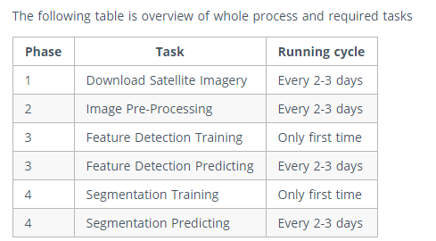
Process

Slide 17
Image Processing and Feature Detection
Image Pre-Processing
Object Detection for Utilities, Training
Object Detection for Utilities, Predicting
Semantic Segmentation for Power Lines, Training
Semantic Segmentation for Power Lines, Predicting

Slide 18
Workflow: Image Pre-Processing
Image Pre-Processing
Object Detection for Utilities
Training
Predicting
Semantic Segmentation for Power Lines
Training
Predicting
Download Sentinel satellite products from data sources
Extract specified spectral bands to low resolution image sets
Remove clouds by using cloud masks (provided in satellite product) and replace content from other images (this method is called mosaicking)
Predict new high-resolution candidate images from low resolution images
Stack the candidate images and extracting details to high quality image

Slide 19
Workflow: Object Detection for Utilities
Training
Training
Object Detection for Utilities
Get provided labels for images or make new if none provided
Build training and validation sets
Build MXNET model for object detection (use algorithms like yolo etc.)
Save model architecture and parameters for predicting
Predicting
Image Pre-Processing
Training
Predicting
Semantic Segmentation for Power Lines
Predicting
Get new satellite images through already built image preprocessing workflow
Get model architecture and trained parameters
Run prediction and save results

Slide 20
Workflow: Semantic Segmentation for Power Lines
Training
Training
Object Detection for Utilities
Get provided labels for images or make new if none provided
Build training and validation sets
Build MXNET model for image segmentation (use algorithms like u-net etc.)
Save model architecture and parameters for predicting
Predicting
Image Pre-Processing
Training
Predicting
Semantic Segmentation for Power Lines
Predicting
Get new satellite images through already built image preprocessing workflow
Get model architecture and trained parameters
Run prediction and save results

Slide 21
Known issues
If system runs out of resources, it might be required to partition images to smaller parts to have smaller requirements for resources
If Turing or Volta GPU is not available, it's necessary to run super resolution with custom model
In Proof-of-Concept project it's necessary to focus smaller part of images because of the small time window for the POC
We couldn’t get everything linked in the demo, but the scripts can be found in github repository (see appendix at the end)

Slide 22
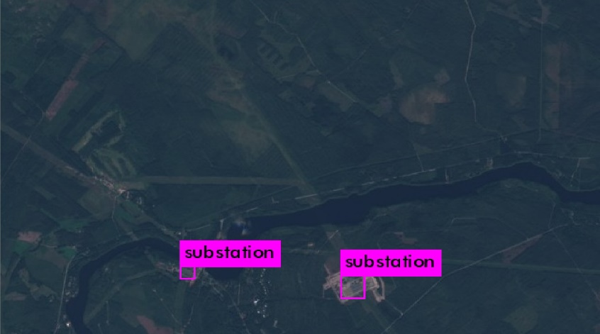
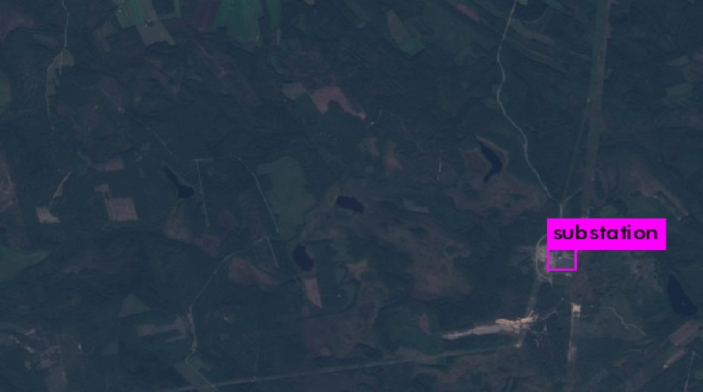
Substation detection
Substation object detection is trained using darknet and yolo. Images for training were Sentinel-2 data products obtained from Copernicus open access hub.
https://github.com/AlexeyAB/darknet
https://scihub.copernicus.eu/dhus/#/home
~1500 images were used in training set and ~600 in test. Training was stopped after 1500 iterations
Current model is able to achieve mAP value of ~45 against the test imageset

Slide 23

Substation detection

Slide 24

Substation detection

Slide 25
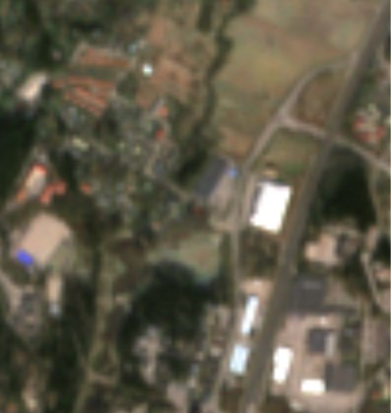
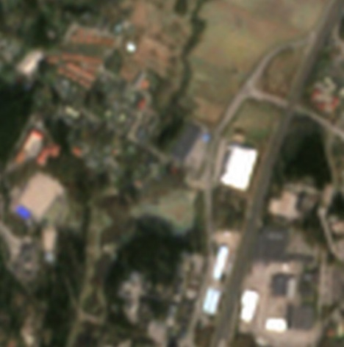
Super resolution
Idea was to test if high resolution images from Google Earth could be used to train a super resolution model to increase accuracy of Sentinel-2 satellite images.
Model is created using mxnet and python.
https://mxnet.apache.org/
Images were downloaded from Google Earth at 4k resolution and then cropped multiple images of size 384 x 216. Total amount of images used in training was over 12000
Best results were obtained when model was trained to increase the resolution by x3. Results show slight improvement in detail. Next steps would be to test if much larger (~100 000) set of images would give even better results and to see if the increased resolution helps in object detection.

Slide 26
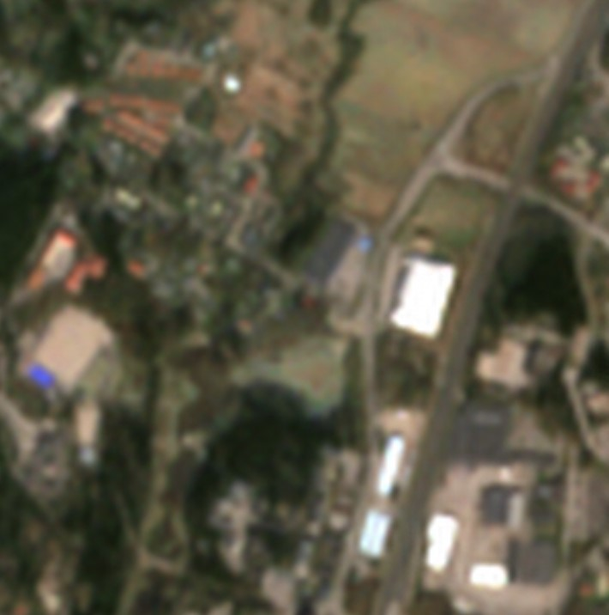
Super resolution

Slide 27
Labelling power:substations using Overpass API
Labels.py will fetch coordinate data for substations using Overpass API. It needs as an input a satellite picture of size 10 980 x 10 980 pixels. Area can be changed as wanted by modifying variable values in the beginning of the script.
Script will crop pictures of size 640 x 400 from a source satellite picture. Each picture contains a power:substation object. A label file (gt file) will be created. Label file contains coordinates and width and height for a substation in each picture.

Slide 28
Cropping pictures and creating a label coordinate file
Save satellite picture in .jpg format into the same directory with labels.py file
Run main function in Labels.py with the following parameters:
folder: give the folder where .jpg file is located in
srcFile: give the name of the .jpg file
tgtFile: give name for the gt file, the labels are stored here
repeatCntr: how many times the process is executed, each process will produce one picture per substation object in the source picture area, area around a certain object is randomly different by each process in the cropped picture

Slide 29
Appendix: Sources and References
https://media.asf.Alaska.edu/uploads/pdf/current_data_recipe_pdfs/create_a_dem_from_sentinel_1_v1.3.pdf
https://forum.step.esa.int/t/slower-snappy-processing/6354/5
https://forum.step.esa.int/t/export-mask-pixels-with-snappy/6280/5

Slide 30


THANK YOU!

